Slide 1
SQL - Join
Key Concepts:
Join brings tables together to allow a query to include results from multiple tables.
Types of Join:
Cross Join (Cartesian Product)
Inner Join (Cross Join followed by condition)
Outer Join (includes non-matching rows)
Left, Right, Full
Usually a Join is done by matching a FK in one table with its PK in another table.
Self Join, Composite Join
Logical vs Physical Processing
Multi-Table Joins

Slide 2
CROSS JOIN
A cross join of two tables produces a table which has a row for every pair of rows in the original tables.
If table A has m rows and table B has n rows, the table that results from the CROSS JOIN will have mn rows.
Equivalent to Cartesian product.
MS SQL Server supports 2 syntaxes, ANSI SQL-92 and ANSI SQL-89.

Slide 3
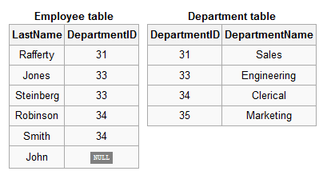
Cross Join Example
ANSI SQL-92 (Recommended):
SELECT *
FROM Employee CROSS JOIN Department;
ANSI SQL-89 (implicit cross join):
SELECT *
FROM Employee, Department;

Slide 4
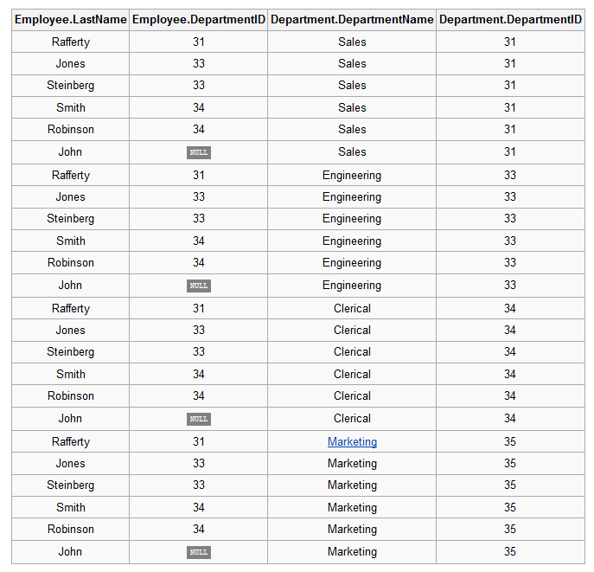
Cross Join Example Result

Slide 5
Cross Join – Another Example
USE TSQLFundamentals2012;
SELECT C.custid, E.empid
FROM Sales.Customers AS C
CROSS JOIN HR.Employees AS E;
91 rows in Sales.Customer.
9 rows in HR.Employees.
Result has 819 rows.
Note: If the 2 tables have the same column name, you must precede the column name by the table name (or alias).
Even if the column names differ, it is good practice to include the table name.

Slide 6
Inner Join
An Inner Join filters the result of a cross join using a predicate.
Often used to find all rows that have the same value in two columns, one in each table.
The most common predicate equates the PK of one table with the FK of another.
INNER JOINs are the most commonly used join.
If the type of JOIN is not specified, INNER is assumed. But it's clearer to include "INNER".

Slide 7
Inner Join Example
Example:
ANSI SQL-92 (Recommended):
SELECT *
FROM Employee INNER JOIN Department
ON Employee.DepartmentID = Department.DepartmentID;
ANSI SQL-89:
SELECT *
FROM Employee, Department
WHERE Employee.DepartmentID = Department.DepartmentID;

Slide 8
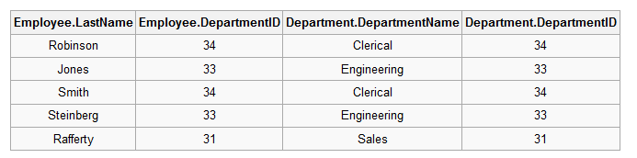
Inner Join Example
Input Tables:
Output Table
INNER JOIN
NOTE: The DepartmentID column appears TWICE.
The ON clause only returns rows for which the predicate is TRUE,
not FALSE or UNKNOWN.
Recall that NULL never matches any other value (not even NULL itself).
Thus rows with NULL will not appear in the result,
unless the join condition explicitly uses IS NULL or IS NOT NULL.

Slide 9
Logical vs Physical Processing
Logically, the result of an inner join is defined as the Cartesian product filtered by the predicate.
NOTE - This means that:
(1) A Cross Join followed by a WHERE clause is the same as an Inner Join where the condition is placed in the ON clause.
i.e. table1 CROSS JOIN table2 WHERE condition
is the same as
table1 INNER JOIN table2 ON condition
(2) An Inner Join with an ON clause that is True for every row (e.g ON 1=1) results in the Cross Join.
Don't do this! It's confusing to the reader.
The actual physical operations implemented by the DBMS may be different, for reasons of efficiency, but are guaranteed to produce the same result.

Slide 10
ANSI 92 vs ANSI 89
The ANSI 92 syntax is recommended because it produces an error if you mistakenly leave the condition out.
ANSI SQL-92:
SELECT *
FROM Employee INNER JOIN Department;
This gives an error because there is no ON clause.
ANSI SQL-89:
SELECT *
FROM Employee, Department;
This computes a cross join instead of the desired inner join.

Slide 11
Outer Join
An Outer Join is an Inner Join but in addition the rows from either the left, right or both input tables that didn't satisfy the predicate (called the "outer" rows) are included in the result, with NULLS for the attributes in the other table.
LEFT OUTER JOIN adds all rows from the left input table that didn't satisfy the ON clause.
RIGHT OUTER JOIN adds all rows from the right input table that didn't satisfy the ON clause.
FULL OUTER JOIN adds all rows from both input tables that didn't satisfy the ON clause.

Slide 12
Left Outer Join
Input Tables:
SELECT *
FROM Employee LEFT OUTER JOIN Department
ON Employee.DepartmentID = Department.DepartmentID;
NOTE: The OUTER keyword is optional.

Slide 13
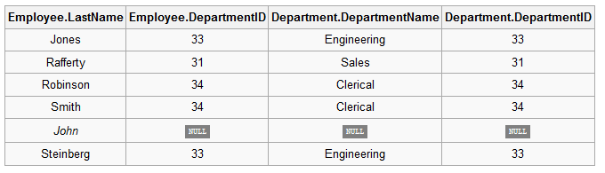
Left Outer Join
Output Table
LEFT OUTER JOIN
Result contains:
All rows with Employee.DepartmentID = Department.DepartmentID (the inner rows)
All the rest of the rows from Employee (the outer rows).
These are included because the Department.DepartmentID is treated as NULL.

Slide 14
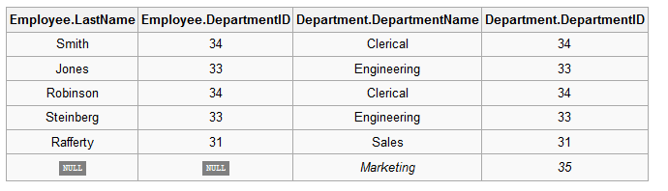
Right Outer Join
SELECT *
FROM Employee RIGHT OUTER JOIN Department
ON Employee.DepartmentID = Department.DepartmentID;
Input Tables:
Output Table
RIGHT OUTER JOIN

Slide 15
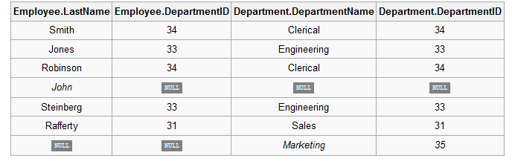
Full Outer Join
SELECT *
FROM Employee FULL OUTER JOIN Department
ON Employee.DepartmentID = Department.DepartmentID;
Input Tables:
Output Table
FULL OUTER JOIN

Slide 16
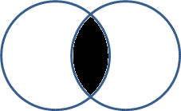
Joins
The different joins can be pictured as followed.
Inner Join (NOT Intersection)
Left Outer Join
Right Outer Join
Full Outer Join (NOT Union)

Slide 17
Facts About Join
INNER JOIN is commutative: for all tables x, y.
x INNER JOIN y = y INNER JOIN x
INNER JOIN is associative: for all tables x, y, z,
(x INNER JOIN y) INNER JOIN z = x INNER JOIN (y INNER JOIN z)
OUTER JOIN is NOT commutative:
usually x LEFT OUTER JOIN y ≠ y LEFT OUTER JOIN x
in fact x LEFT OUTER JOIN y = y RIGHT OUTER JOIN x
OUTER JOIN is NOT associative: it is possible to find tables x, y, z such that
(x LEFT OUTER JOIN y) LEFT OUTER JOIN z ≠
x LEFT OUTER JOIN (y LEFT OUTER JOIN z)
NOTE: It is WRONG to say that Outer Join adds the rows with NULLs. It adds the rows that don't match the ON clause, whether or not they have NULLs.

Slide 18
When to use Outer Join?
An example illustrating when Outer Join is useful instead of Inner Join.
Suppose we want to show each customer’s orderids, including customers who have not made any orders.
The following will NOT work, because it only includes customers who have placed orders.
SELECT C.companyname, O.orderid
FROM Sales.Customers AS C INNER JOIN Sales.Orders AS O
ON C.custid = O.custid
The following works.
It includes 2 customers not found in the results of the Inner Join, with NULL in the orderid column.
SELECT C.companyname, O.orderid
FROM Sales.Customers AS C LEFT OUTER JOIN Sales.Orders AS O
ON C.custid = O.custid

Slide 19
Deciding Which Join to Use
Often deciding which JOIN to use requires interpreting the intention of the person requesting the information.
E.g. Show how many classes are being taken by each student.
This will require joining the table of students with the table
showing which classes each student is taking.
Consider students not taking any classes.
Should these students be included (with a count of 0)?
If yes, use OUTER JOIN.
If no, use INNER JOIN.

Slide 20
WHERE vs ON
Should a condition be placed in the ON clause of a JOIN or the WHERE clause of the SELECT?
If the condition is specifying which rows in the one table should be matched with rows in the other table, put it in the ON clause of the JOIN.
ON does not determine which rows appear in the output.
ON determines which rows are matched with rows in the other table.
If the condition needs to be applied to the result of the JOIN to filter some of the rows, put it in the WHERE clause of the SELECT.

Slide 21
Watch out for WHERE in Outer Join
Suppose you have a LEFT OUTER JOIN and a WHERE clause that refers to an attribute in the right table.
E.g. SELECT some columns here
FROM table1 LEFT OUTER JOIN table2
ON table1.col1 = table2.col2
WHERE table2.someColumn someCondition
NOTE:
The non-matching rows (the “outer” rows) have NULL in table2’s attributes.
So the condition yields UNKNOWN.
WHERE filters out rows that yield UNKNOWN.
So all outer rows are filtered out.
Therefore the OUTER JOIN is pointless; it has the same effect as an inner join.

Slide 22
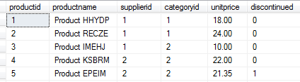
Self Joins
A self join is when a table is joined to itself.
Use table aliases so columns are not ambiguous.
Cross Joins, Inner Joins, and Outer Joins can all be self joins.
Self-joins are very useful for finding pairs of elements.
E.g. Find all pairs of products from the same supplier.
First look at the Production.Products table.

Slide 23
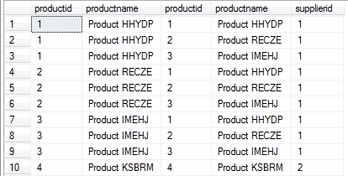
Finding Pairs
Join the table to itself, matching the supplier id.
SELECT P1.productid, P1.productname, P2.productid, P2.productname, P1.supplierid
FROM Production.Products AS P1 JOIN Production.Products AS P2
ON P1.supplierid = P2.supplierid
Notice that:
Each product appears paired with itself.
The same pair appears more than once (e.g. 1,2 in row 2 and 2,1 in row 4).
We probably don't want this.

Slide 24
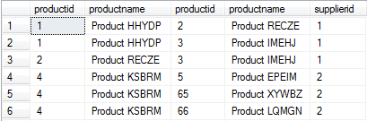
Finding Pairs (ctd)
To get only the distinct pairs:
SELECT P1.productid, P1.productname, P2.productid, P2.productname, P1.supplierid
FROM Production.Products AS P1 JOIN Production.Products AS P2
ON P1.supplierid = P2.supplierid AND P1.productid < P2.productid
Instead of INNER JOIN with ON, CROSS JOIN with WHERE also works:
SELECT P1.productid, P1.productname, P2.productid, P2.productname, P1.supplierid
FROM Production.Products AS P1 CROSS JOIN Production.Products AS P2
WHERE P1.supplierid = P2.supplierid AND P1.productid < P2.productid

Slide 25
Composite Join
A composite join is a join whose predicate involves multiple attributes (columns) from each relation (table).
Both Inner Joins and Outer Joins can be composite joins.
E.g. SELECT someColumns
FROM dbo.Table1 AS T1 INNER JOIN dbo.Table2 AS T2
ON T1.col1 = T2.col1 AND T1.col2 = T2.col2
NOTE: Most Inner and Outer Joins involve a FK column being set equal to the PK column in the other table. But later we will see some other useful examples of Joins.
For an example where this is NOT the case, see the slides on "Table Expressions", where we calculate the difference between the number of customers who placed orders in each year and the previous year by joining a table to itself on the predicate orderyear = orderyear +1.

Slide 26
Multi-Table Joins
A join operator takes two tables, but a single query can have multiple joins, which are logically processed from left to right.
In the FROM clause:
The first two tables are processed;
The output of step 1 and the next table are processed;
The output of step 2 and the next table are processed;
And so on.
The database engine may internally rearrange the order of the joins for efficiency without effecting the correctness of the result.

Slide 27
Multi-Table Join Example
Using TSQLFundamentals2012:
Suppose you want a result that has the following for each sale:
The name of the customer (in table Sales.Customer)
The name of the product being ordered (in table Production.Product)
The quantity ordered (in tableSales.OrderDetails).
NOTE:
There is no attribute in common between Sales.Customer and Production.Product;
There is a an attribute in common between Sales.OrderDetails and Production.Product - namely productid;
There is no attribute in common between Sales.Customer and Sales.OrderDetails ;
There is an attribute in common between Sales.Customer and Sales.Order -namely custid;
There is an attribute in common between Sales.Order and Sales.OrderDetails - namely orderid;

Slide 28
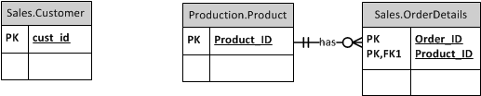
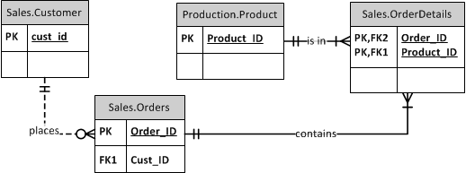
Multi-Table Join Example (ctd)
Want to join these tables, but no common attribute exists between
Sales.Customer and Sales.OrderDetails.
Use Sales.Orders to bridge the gap:

Slide 29
Multi-Table Join Example (ctd)
SELECT C.custid, C.companyname, P.productname, OD.qty
FROM Sales.Customers AS C
INNER JOIN Sales.Orders AS O
ON C.custid = O.custid
INNER JOIN Sales.OrderDetails AS OD
ON O.orderid = OD.orderid
INNER JOIN Production.Products AS P
ON OD.productid = P.productid;

